Slide 1
An Environmental Sustainability Program: A Guide for Managers
What is Environmental Sustainability?
Benefits of an Environmental Sustainability program
Why we are using My Green Doctor
Environmental Sustainability Topics
Structure of our Environmental Sustainability program
Responsibilities of Managers
Activities of our Environmental Sustainability Program
Ther Green Doctor Office Recognition Certificate
Success stories
Our success timetable

Slide 2
Environmental Sustainability is for us a “Core Value”
June, 2015

Slide 3
An environmentally sustainable organization is one that:
“meets the needs of the present without compromising the ability of future generations to meet their own needs.”
World Commission on Environment & Development, 1987

Slide 4
Benefits of an Environmental Sustainability Program
improves office business processes
builds a culture of saving resources
lowers business operating costs
supports the values of employees who want to “make a difference”
promotes colleagues sharing ideas
brand enhancement
fosters a healthier work environment
leads to healthier patients & community

Slide 5
Why We Are Using My Green Doctor
Since 2010, My Green Doctor is the world’s leading environmental sustainability program for outpatient healthcare offices, clinics and facilities.
Provided by 28 health professional societies and used by thousands of healthcare practice in more than 80 countries
Comprehensive, evidence-based, written by health professionals
Easy to use; no science or environmental background needed
Proven to work.
A free website found at www.MyGreenDoctor.org
Many free teaching tools: brochures, posters, handouts

Slide 6
Environmental Sustainability Topics
Energy use
Saving water
Recycling
Safe use of chemicals
Healthy food choices
“Green” purchasing
Climate change awareness
Pharmaceuticals disposal
Transportation choices
Landscape & gardening
Renewable energy
Patient teaching

Slide 7
Structure of our Sustainability Program
Adopt Environmental Sustainability as a “Core Value”
Large companies only: create an Environmental Sustainability Council (ESC)
meets quarterly
coordinates our Environmental Sustainability Program
reports annually to our Board of Directors
rewards performance
Place My Green Doctor on the agenda of staff meetings at least once a month
adds 5 minutes to the agenda
follow the script of MGD’s Meeting-by-Meeting Guide
assign someone to record Green Team Notes to send
to our ESC or to My Green Doctor
D. Qualify for the Green Doctor Office Recognition Certificate

Slide 8
Responsibilities of Managers
Managers are asked to make an environmental sustainability program a regular feature of their office, clinic, or outpatient facility.
This is a gradual process introduced over several months
Use the My Green Doctor program as our guide
Likely to require no more than twenty minutes per month
Likely to be interesting & satisfying for managers and their staff

Slide 9
Responsibilities of Managers
Register at My Green Doctor (MGD): www.MyGreenDoctor.org
Use MGD as your guiding resource for the office
Add five minutes of My Green Doctor once a month to the
staff or business meeting
Use the “Meeting-by-Meeting Guide” to direct each meeting:
nothing for the manager to study or prepare
Encourage teamwork and staff leadership on specific projects
Report quarterly to the Environmental Sustainability Committee
Qualify for Green Doctor Office recognition Certificate from MGD
And keep going with My Green Doctor on your agendas!

Slide 10
Activities of our Environmental Sustainability Program
Five minutes of My Green Doctor on our meeting agenda monthly
These sessions can be led by the Office Manager or another leader.
We’ll follow the script provided in My Green Doctor’s Meeting-by-
Meeting Guide
Choose 1-2 Action Steps to begin each month
Find at Leader for each Action Step
Choose Education Steps in My Green Doctor to share ideas
with our colleagues & patients.
Record our meeting minutes using the Green Team Notes
form from My Green Doctor
Qualify by 6 months for Green Doctor Office Recognition Certificate

Slide 11
Green Doctor Office Recognition Certificate
Recognizes your ongoing commitment to a healthier office
& community
Requires completion of five environmental sustainability
meetings, five Action Steps, and five Education Steps
The certificate is valid for 3 years
My Green Doctor will continue on our monthly agenda as
something important that we are proud of!

Slide 12
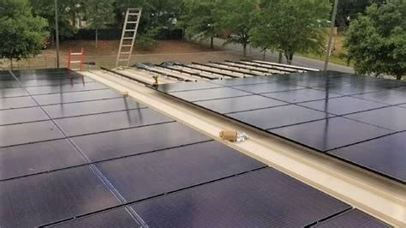
A Sustainability Success Story: The Escambia County Health Department
Five offices in Florida Panhandle
Saving energy every month
5.2% energy electricity saving per year
125,000-kilowatt hours electricity per year
85,600 metric tons CO₂ per year
Bottom Line: $14,000 saved annually

Slide 13
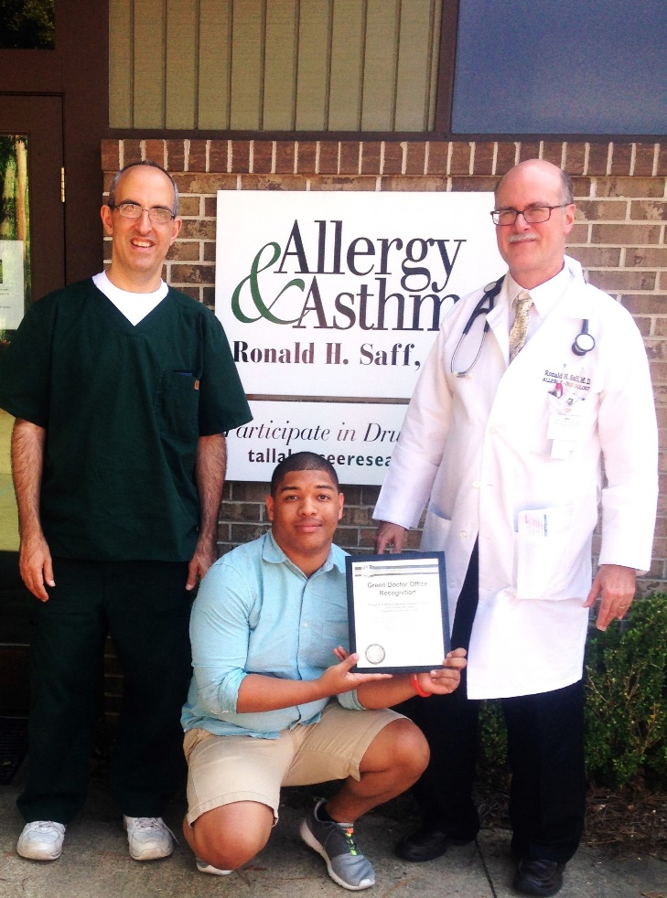
Success Story: Allergy & Asthma Diagnostic Treatment Center, Tallahassee, FL
Topics addressed:
Water conservation
Energy saving: used less hot water, turned off lights, installed “smart” power switches
Recycling program & recycling education
Decreasing printing & paper use
Brochures, signs, & handouts for patients

Slide 14
Our Success Timetable
Month 1: Environmental Sustainability Council meets
Month 2-3: First My Green Doctor 5-minute sessions on agendas
Month 6-8:
Sustainability programs in 100% of offices & departments
5% energy savings compared with prior year
100% of offices & departments qualify for My Green Doctor’s
Green Doctor Office Recognition certificate
After Month 8: Continue our monthly 5-minute sessions

Slide 15
Our Environmental Sustainability Program: Summary for Managers
Make Environmental Sustainability a core value that can lower our operating costs & make for a healthier community.
Register at www.MyGreenDoctor.org .
Managers are asked to add 5-10 minutes of My Green Doctor business to each staff meeting, using My Green Doctor’s Meeting-by-Meeting guide as our script.
Encourage involvement by your staff members.
Plan to achieve Green Doctor Office Recognition by 8 months.

Slide 16
“Thank you for helping us to save money and to create a healthier office and community!”

